Slide 1
PEBBLE BioFusion
Summer School 2026
Day-4 Tutorial :
Aging clocks
based on accumulating stochastic variation
Yihao Lin

Slide 2


Are two people of the same age are equally old?
Workforce entrants
Direct doctoral admits
Chronological Age: 24 years old years 24 years old years
Biological Age: 24 years old years 42 years old years

Slide 3

The physiological age cannot be directly measured.
We can search for biomarkers of aging!
DNA methylation
An ideal aging biomarker should show reproducible changes with age
24 years old years
80 years old years
It would also be better if it can reflect differences in health status and mortality risk among people of the same age.
24 years old years
24 years old years
Accelerated aging！

Slide 4
DNA methylation is a chemical modification that mainly occurs on cytosine, and it affects whether genes can be easily read.
Phosphate Group
P
P
O
O
C
C
C
C
Methylation
M
P
P
O
O
C
G
G
C
5
4
1
Basic Group
3
2
Pentose

Slide 5
DNA methylation patterns change dynamically during the lifespan.
M
C
G
C
A
T
G
A
0 0 1 0 0 0 0
0 0 0 0 0 1 0
O
P
C
C
G
C
G
T
A
C
T
1-Em
M
Ed
t+1
t+1
M
M
M
C
G
C
A
T
G
A
O
1 0 1 0 0 0 0
0 0 0 0 0 0 0
P
C
C
G
C
G
T
A
C
T

Slide 6
DNA methylation at certain sites changes during the aging process, and it can serve as a biomarker that indicates biological age. This marker is called an epigenetic clock.
Cell 1
0 0 1 0 0 0 0
0 0 0 0 0 1 0
Calculate the average
10 year later
0.1 0 1 0 0 0 0
0 0 0 0 0 0.1 0
0.11 0 1 0 0 0 0
0 0 0 0 0 0.12 0
Cell 2
1 0 1 0 0 0 0
0 0 0 0 0 0 0
.
.
.
Change
∼0.1%–0.2%/year
Since DNA methylation can predict age, can we build a unified clock that works across all tissues and cell types?
Cell n

Slide 7


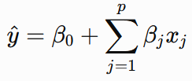
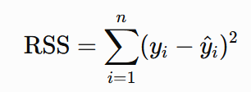
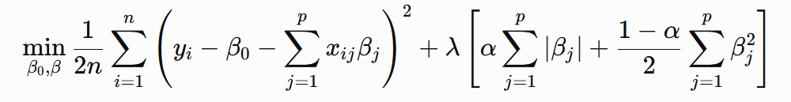
Steve Horvath used elastic net to build a methylation clock with 353 sites in 2013.
Measure a large
amount of CpG
Assign them
different weights
Calculate the weighted sum of it
as the predicted value
Calculate the sum of
squared errors
The complete elastic net objective function is usually written as：
Minimum Error Squared
L1 penalty
L2 penalty

Slide 8
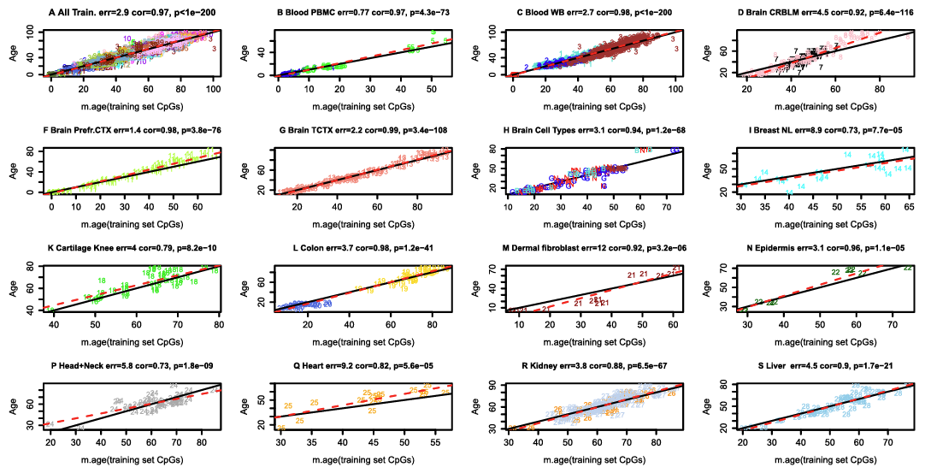
This clock can predict age in multiple tissues, so it identified a set of age-related signals that are shared across tissues.

Slide 9
Chronological Age
24 years old years
24 years old years
Horvath Clock
24 years old years
40 years old years
Accelerated aging: 40- 24 = 16 years !
We now have a preliminary estimate of relative aging acceleration,
but does a higher Horvath Clock-age necessarily mean a higher risk of illness?
The association is not direct.

Slide 10
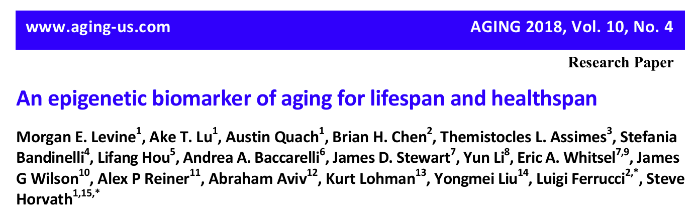
PhenoAge first incorporated mortality risk into the construction target of clinical phenotypic age. Then it used DNA methylation to predict this age, which is closer to health status.
A one-year increase in DNAm PhenoAge raises all-cause mortality by 9%.

Slide 11
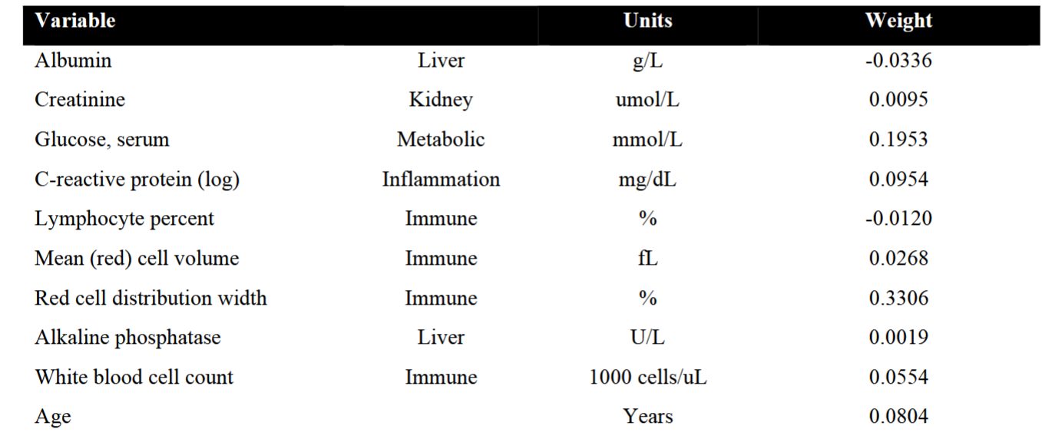
Phenoage is defined by the following indicators.

Slide 12
Can we conclude that a directed aging program must underlie the methylation changes?
Has direction;
Highly predictable;
Cross-individual repeatable;
Cross-organally relatively coordinated;
Can be reprogrammed "reset";
The clock positions are often associated with developmental regulatory regions.
When these features are combined, they resemble a sequential developmental process!

Slide 13
Bulid Aging clocks
based on accumulating stochastic variation
Module 1 Simulated data: when can symmetric noise create a learnable age signal?
--Even if the noise itself is perfectly symmetric and has zero mean, an asymmetric system response to this noise can still generate learnable age signals.
Module 2 Horvath clock applied to simulated random methylation drift.
--The methylation patterns that the Horvath clock relies on overlap with the directional changes produced by random drift.”
Module 3 A clock trained only on simulated data predicting real ages.
--The structure of real human methylation changes with age shares common components with the structure produced by a random maintenance error model.

Slide 14
Module 1 Simulated data:
when can symmetric noise create a learnable age signal?

Slide 15
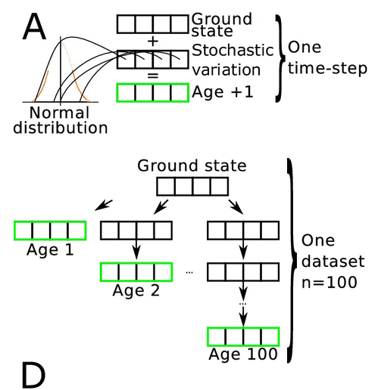
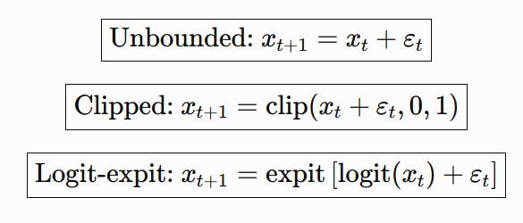



Simulation can generate individual samples of different ages.

Slide 16
How can we understand that truncation causes the system's response to noise to be asymmetric?
Stochastic disturbance（Gaussian）
1
1
Met level
Met level
1
1
Met level
0.5
Met level

Slide 17
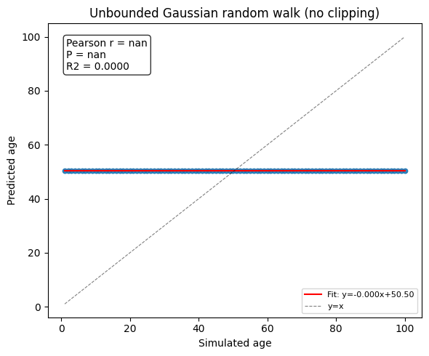
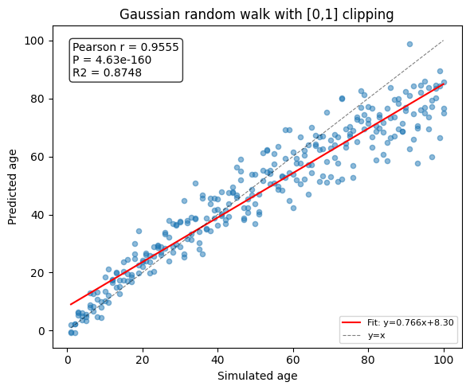
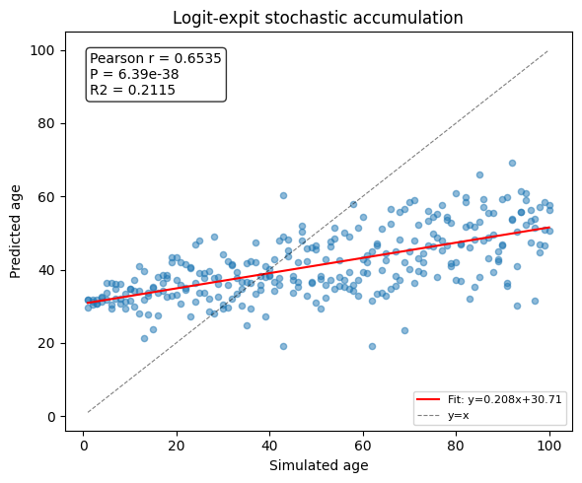
The asymmetric system response to noise leads to the generation of learnable age signals.
Cell 8
Cell 11
Cell 14
The model essentially learns a mean-reversion process.

Slide 18
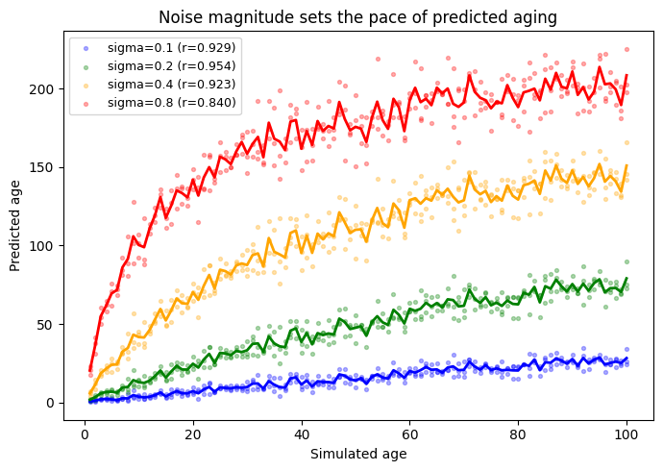
The strength of random fluctuations affects the speed of the clock.
Cell 17

Slide 19
Module 2
Horvath clock applied to simulated random methylation drift.

Slide 20
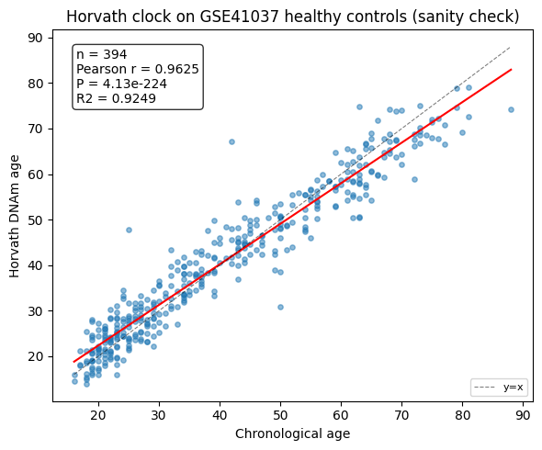
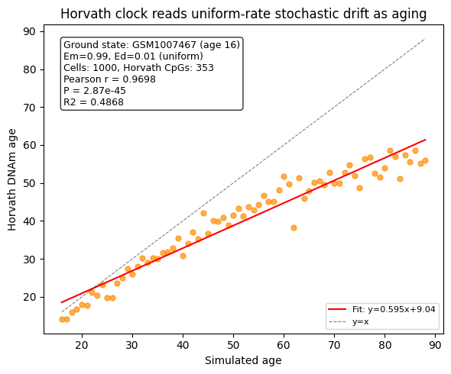
The methylation patterns that the Horvath clock relies on overlap with the directional changes produced by random drift.
Cell 23
Cell 26

Slide 21
Module 3 A clock trained only on simulated data predicting real ages.

Slide 22
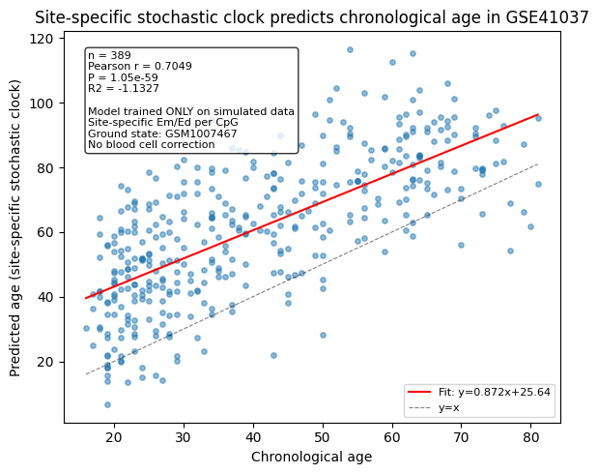
The clock trained based on simulated data can capture the signals that change with age in real data.
Cell 35

Slide 23
Previous study
Find age signal
Clock training in real data
(like Horvath clock)
Real biological data
Conclusion:
The methylation signals within biological tissues contain age-related information!
Module 1
Find age signal
Clock training in simulation data
Accumulating stochastic variation
(Simulated data generated by random perturbation)
Conclusion:
As long as certain conditions are met, the accumulation of stochastic variations can also generate age-related signals.

Slide 24
Module 2
Find age signal
Clock training in real data
(like Horvath clock)
Accumulating stochastic variation
(Simulated data generated by random perturbation)
Module 3
Find age signal
Clock training in simulation data
Real biological data
Conclusion:
The age-related methylation signals in biological tissues actually involve the accumulation of random variations!

Slide 25
In fact, we have only completed a simplified model.
Remaining problem:
1. The Em and Ed at each sites are different! (We fix Em=0.99 and Ed = 0.01)
Expand Part A: Site-Specific Methylation Dynamics
2. We did not account for the influence of changes in blood cell ratios.
Expand Part B: Blood Cell Composition Correction
3. We employed synchronous updates with a fixed time step.
Expand Part C: Gillespie Continuous-Time Event-Driven Simulation

Slide 26



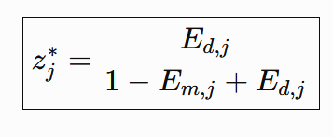



1. The Em and Ed at each sites are different! (We fix Em=0.99 and Ed = 0.01)
Expand Part A: Site-Specific Methylation Dynamics
The already methylated part
Steady-state solution
The unmethylated part
Update rule

Slide 27
Reference:
[1] Horvath, S. DNA methylation age of human tissues and cell types. Genome Biol 14, 3156 (2013). https://doi.org/10.1186/gb-2013-14-10-r115
[2] Levine M, Lu A, Quach A, Chen B, Assimes T, Bandinelli S, Hou L, Baccarelli A, Stewart J, Li Y, Whitsel E, Wilson J, Reiner A, Aviv A, Lohman K, Liu Y, Ferrucci L, Horvath S. An epigenetic biomarker of aging for lifespan and healthspan. Aging (Albany NY). 2018; 10:573-591. https://doi.org/10.18632/aging.101414
[3] Lu A, Quach A, Wilson J, Reiner A, Aviv A, Raj K, Hou L, Baccarelli A, Li Y, Stewart J, Whitsel E, Assimes T, Ferrucci L, Horvath S. DNA methylation GrimAge strongly predicts lifespan and healthspan. Aging (Albany NY). 2019; 11:303-327. https://doi.org/10.18632/aging.101684
[4] Meyer, D.H., Schumacher, B. Aging clocks based on accumulating stochastic variation. Nat Aging 4, 871–885 (2024). https://doi.org/10.1038/s43587-024-00619-x

Slide 28
The physiological age cannot be directly measured.

